Slide 1

School of Electrical Engineering and Computer Science
Department of Electrical Engineering
EE-371 : Control Systems
Lecture#06
(Transfer Functions of Rotational Systems)
Chapter #02
Text Book: Control Systems Engineering by Norman S. Nise 5th Edition
Instructor: Ms Neelma Naz
Class: BEE 12 C/D

Slide 2
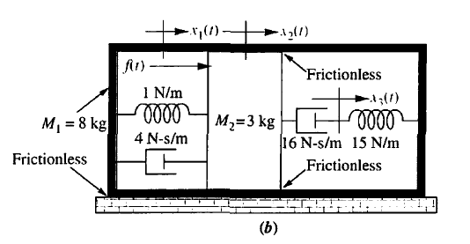
Transfer Functions for Translational Mechanical Systems

Slide 3
Transfer Functions for Rotational Mechanical Systems

Slide 4
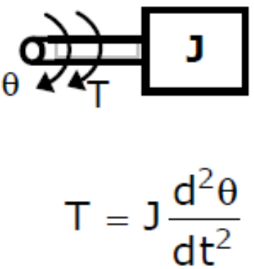
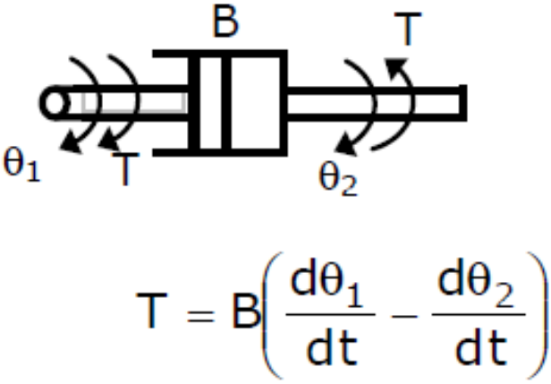
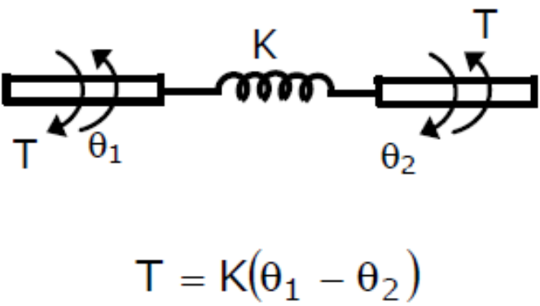
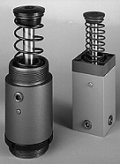
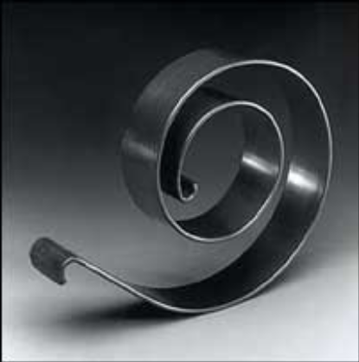
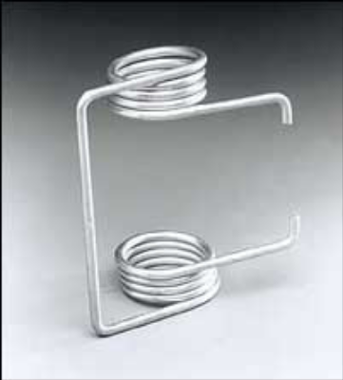
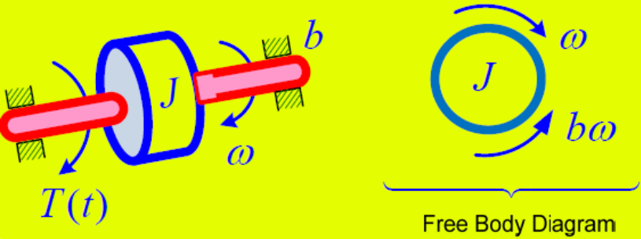
Mechanical Rotational Systems
The mechanical rotational systems are treated in the same way as the mechanical translational systems with the following changes:
Mass (M) is replaced by moment of inertia (J)
Force (F) is replaced by Torque (T)
Displacement ‘X’ by angular displacement ‘θ’

Slide 5
Examples
Mechanical Rotational Systems -Applications

Slide 6
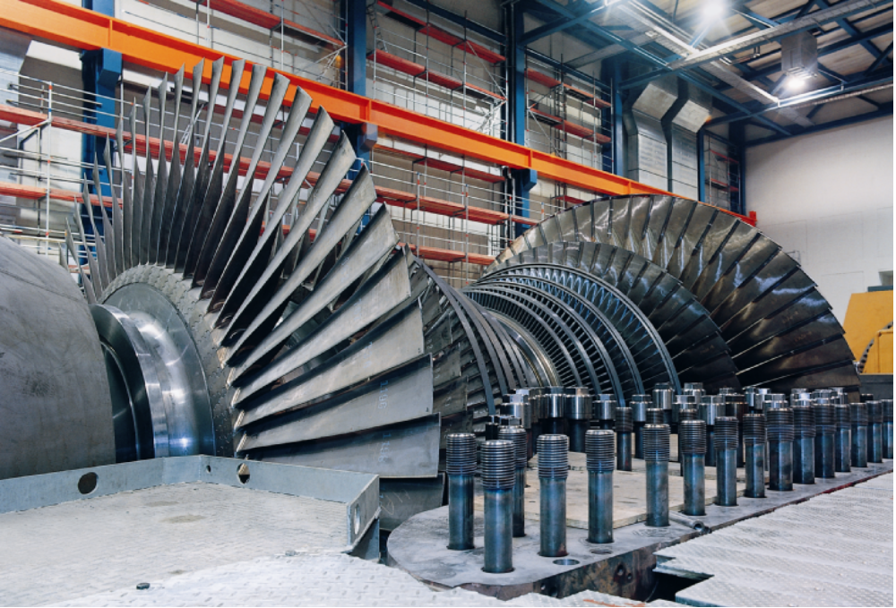
Steam Turbine Blades

Slide 7
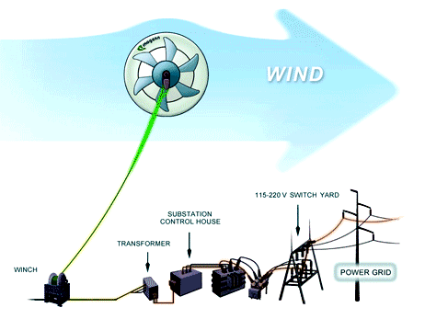

Slide 8
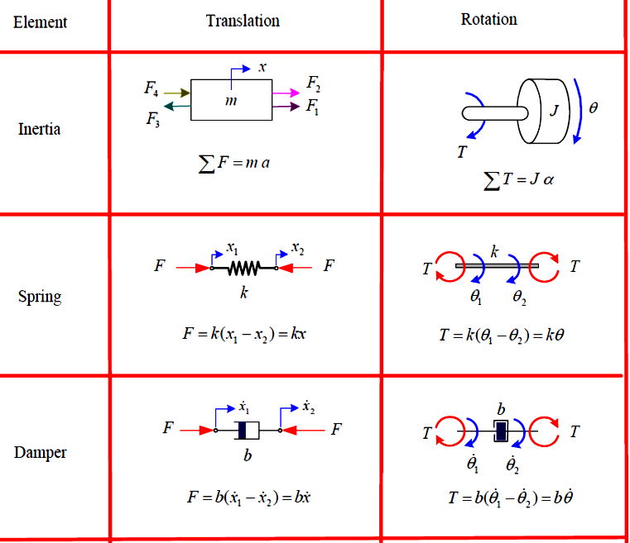
Summary of elements involved in linear mechanical systems

Slide 9
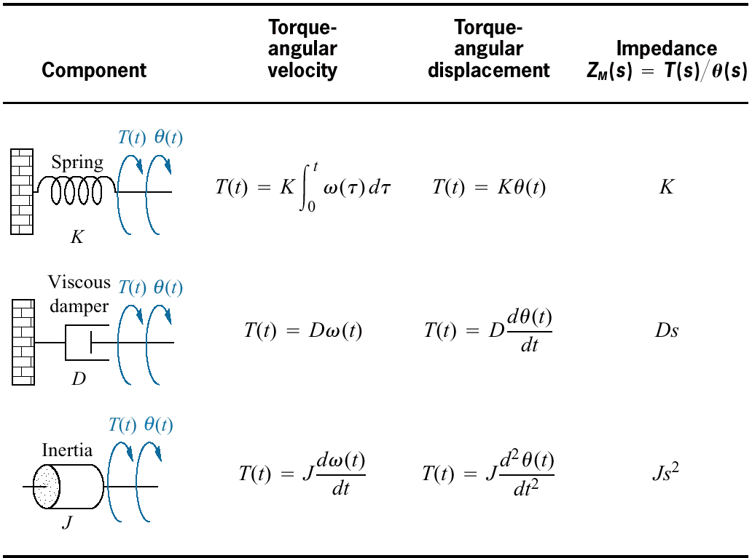

Slide 10
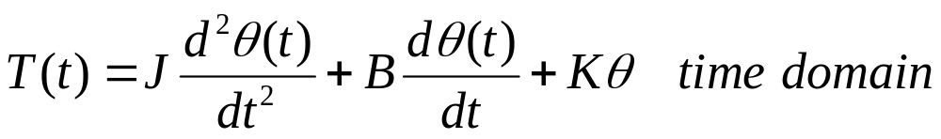
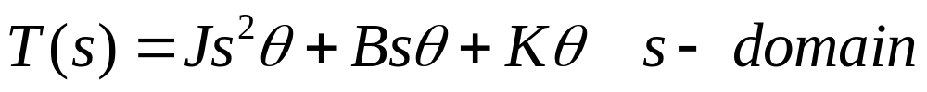
θ
τ
J
B
K

Slide 11
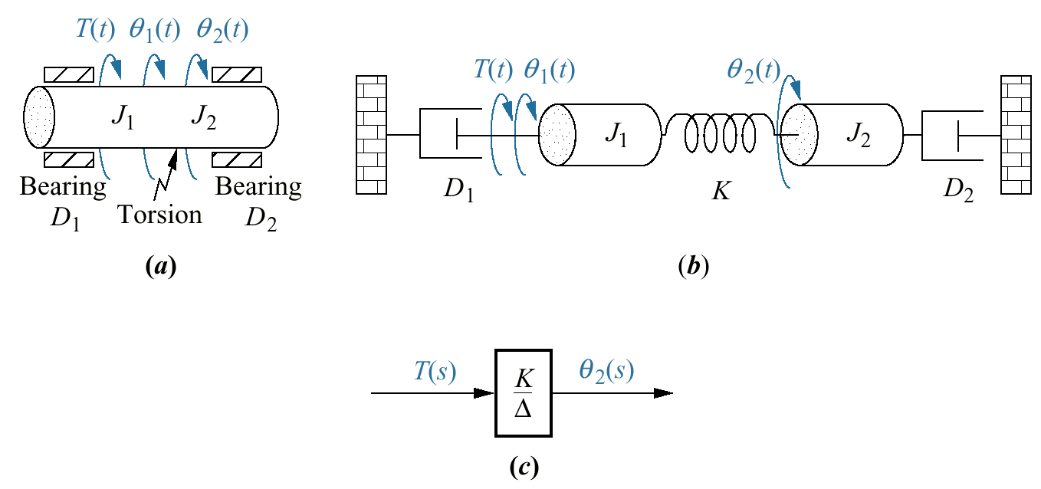
Example 2.19
Physical system
Schematic
Block diagram

Slide 12
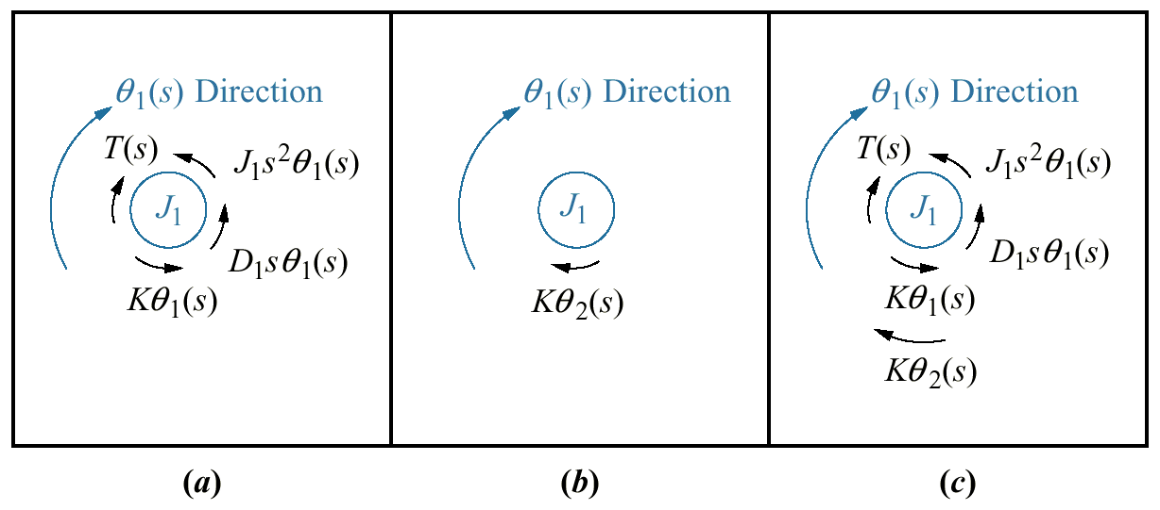
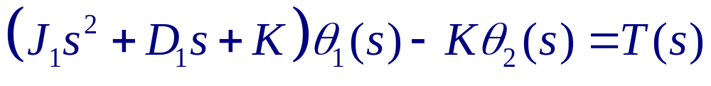
Final free-body
diagram for J₁
Torques on J₁ due only to the motion of J₁
Torques on J₁ due only to the motion of J₂

Slide 13
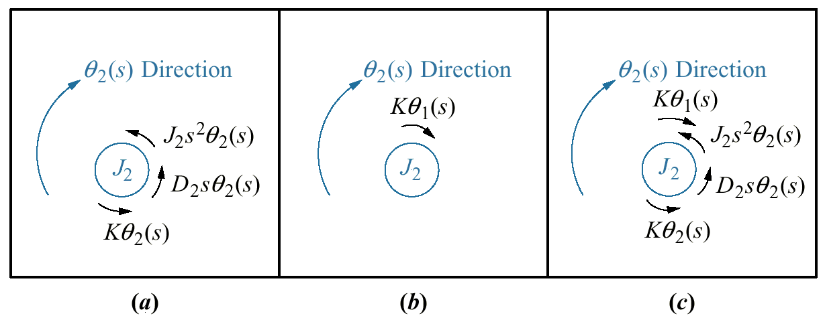
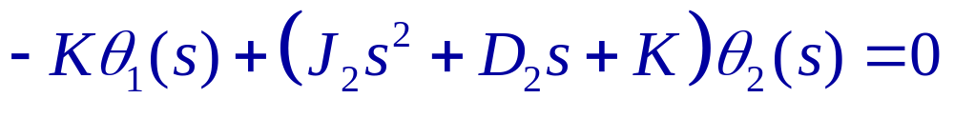
Final free-body
diagram for J₂
Torques on J₂ due only to the motion of J₂
Torques on J₂ due only to the motion of J₁

Slide 14
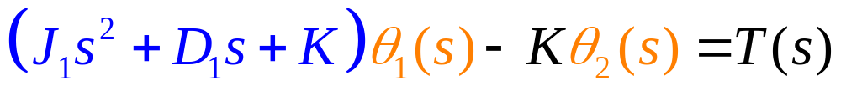
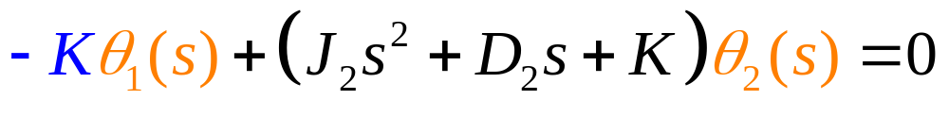

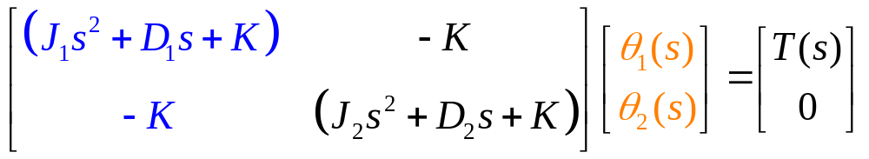


Slide 15
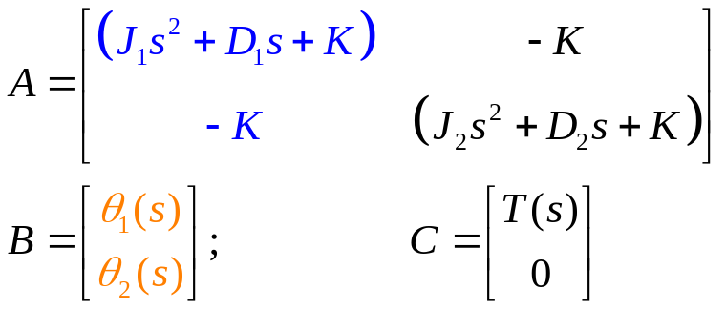
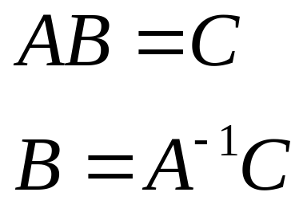
syms s J1 D1 K T J2 D2 theta1 theta2;
A=[(J1*s^2+D1*s+K) -K; -K (J2*s^2+D2*s+K)];
B=[theta1; theta2];
C=[T; 0];

Slide 16
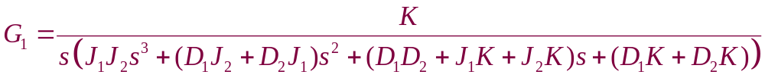
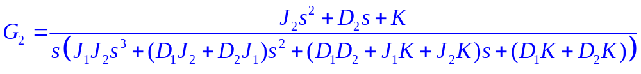
%Example 2.19
syms s J1 D1 K T J2 D2 theta1 theta2;
A=[(J1*s^2+D1*s+K) -K; -K (J2*s^2+D2*s+K)];
B=[theta1; theta2];
C=[T; 0];
B=inv(A)*C;
theta1=B(1);
theta2=B(2);
G1 = theta2/T;
G2 = theta1/T;
G1 =
K/(D1*K*s + D2*K*s + D1*D2*s^2 + D1*J2*s^3 + D2*J1*s^3 + J1*J2*s^4 + J1*K*s^2 + J2*K*s^2)
G2 =
(J2*s^2 + D2*s + K)/(D1*K*s + D2*K*s + D1*D2*s^2 + D1*J2*s^3 + D2*J1*s^3 + J1*J2*s^4 + J1*K*s^2 + J2*K*s^2)

Slide 17
%Example 2.19
syms s J1 D1 K T J2 D2 theta1 theta2;
J1=1; J2=1, D1=1; D2=1;K=1;
A=[(J1*s^2+D1*s+K) -K; -K (J2*s^2+D2*s+K)];
B=[theta1; theta2];
C=[T; 0];
B=inv(A)*C;
theta1=B(1);
theta2=B(2);
G1 = theta2/T;
G2 = theta1/T;
G1 =
1/(s^4 + 2*s^3 + 3*s^2 + 2*s)
G2 =
(s^2 + s + 1)/(s^4 + 2*s^3 + 3*s^2 + 2*s)

Slide 18
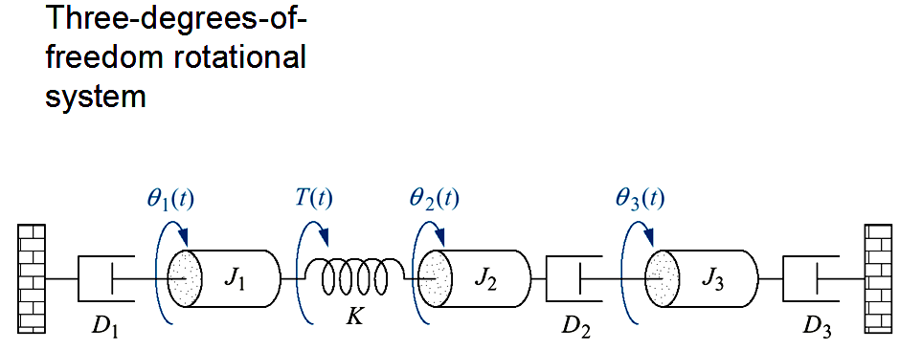
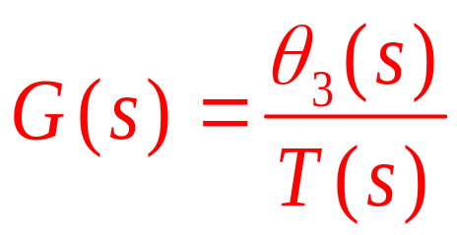
Home Assignment (submit)
  Write the Transfer Function

Slide 19


